Slide 1

Textract
Using
AWS & ML
Team members:
Nandagopal K -312321205113
Joewin Daniel Raj G-312321205082

Slide 2

Abstract
In the rapidly evolving digital age, efficient data extraction from documents is crucial for automating business processes and enhancing decision-making. This mini project demonstrates the integration of Amazon Textract with AWS Lambda and Amazon S3 to develop a robust document processing solution that automates the extraction of key-value pairs from uploaded documents.
The project employs Python programming for scripting the Lambda function, which directs Textract to analyze document images for text and data, categorizes the extracted content into key-value pairs, and outputs these pairs for further analysis or integration into databases and applications. This solution not only streamlines data entry and retrieval but also minimizes human errors associated with manual data extraction.

Slide 3
Introduction
In today's data-centric world, the abundance of unstructured textual data presents both opportunities and challenges for organizations across various industries. Extracting valuable insights from this vast pool of information is crucial for informed decision-making, yet traditional methods of text extraction often prove to be labor-intensive, error-prone, and inefficient. With the advent of machine learning and cloud computing technologies, there arises a promising avenue to revolutionize the process of text extraction, making it more accurate, scalable, and adaptable to diverse sources of textual data.
Recognizing the need for enhanced document processing solutions, this project explores the implementation of a cloud-based, automated system using Amazon Textract, AWS Lambda, and Amazon S3. Amazon Textract is a service that leverages machine learning to automatically extract text, handwriting, and data from scanned documents. AWS Lambda provides a serverless computing environment to execute code in response to events—such as uploading a document to Amazon S3, which serves as a secure storage solution that supports data availability, security, and performance.

Slide 4
Literature Survey
AUTHOR | TITLE | KEY FINDNINGS | OBJECTIVE | METHODOLOGY
Z. Xu, Z. Huang, H. Deng, and Y. Zhao | "Deep Learning for Document Processing : From Text Detection to Text Extraction” | This paper explores the application of deep learning techniques in document processing tasks, particularly focusing on text detection and extraction. | Extracting textual content from images and scanned documents. | It delves into various deep learning architectures, such as convolutional neural networks (CNNs) and recurrent neural networks (RNNs)
S. Garg and R. S. Anand | "A Survey of Text Extraction Techniques" | Techniques, including rule-based, statistical, and machine learning-based approaches, and discusses their strengths, weaknesses, and applications in various domains. | Different text extraction methods employed in document processing | Discusses their strengths, weaknesses, and applications in various domains.
S. Srinivasan and M. Boswell | AWS Machine Learning: A Comprehensive Guide | This book serves as a thorough guide to machine learning implementation within the Amazon Web Services (AWS) ecosystem. | Explaining how these services can be utilized for text extraction tasks and providing practical examples and case studies. | Offers insights into AWS machine learning services, including Amazon Comprehend and Amazon Textract, .

Slide 5
Literature Survey
AUTHOR | TITLE | KEY FINDINGS | OBJECTIVE | METHODOLOGY
M. Allen | “Document Understanding with Amazon Textract" | This AWS whitepaper explores the capabilities of Amazon Textract, a service designed for document understanding tasks | It discusses Textract's ability to extract text and structured data from scanned documents, images, and PDF files | Advanced optical character recognition (OCR) and machine learning algorithms.
E. Chapin | "Natural Language Processing with AWS" | Provides a comprehensive overview of natural language processing (NLP) techniques and their implementation using AWS services | Text processing tasks, including sentiment analysis, entity recognition, and topic modeling | Demonstrating how AWS services like Amazon Comprehend can be leveraged for efficient NLP applications.
P. Mohanty and S. K. Patel | "Text Extraction from Images: A Review" | Examines different methodologies for extracting text from images, focusing on both traditional computer vision techniques and recent advancements. | It discusses challenges such as text detection, localization, and recognition | Providing insights into the state-of-the-art in text extraction from images.

Slide 6
Literature Survey
AUTHOR | TITLE | KEY FINDINGS | OBJECTIVE | METHODOLOGY
J. Smith | "Scalable Document Understanding with Amazon SageMaker" | Text extraction and other document processing tasks, making it suitable for handling large-scale document datasets. | This article explores the scalability of Amazon SageMaker for document understanding tasks. | . It discusses how SageMaker's distributed training and inference capabilities can be utilized for training and deploying machine learning models
A. Sharma and R. Jain | "Efficient Text Extraction Techniques for Large-Scale Document Analysis" | It proposes optimization strategies and parallel processing approaches to improve the scalability and performance. | This research paper focuses on developing efficient text extraction techniques for analyzing large-scale document collections. | Improve the scalability and performance of text extraction algorithms, particularly in the context of processing vast amounts of textual data..
R. Bissacco and J. Z. Kolter | "OCR and Information Extraction: A Survey" | This survey paper provides a comprehensive overview of optical character recognition (OCR) techniques and information extraction methods. | Evolution of OCR algorithms, recent advancements in deep learning-based OCR approaches | It discusses the evolution of OCR algorithms, recent advancements in deep learning-based OCR approaches, and their applications in extracting information.

Slide 7
Existing Model:
It will not run on serverless architecture.
It did not focus on performance and cannot process large volume of documents

Slide 8
Proposed System:
Scalability and Performance Optimized by leveraging AWS lambda’s serverless architecture,using batch processing for large volumes of documents and implementing catching and optimization techniques to improve the processing speed

Slide 9
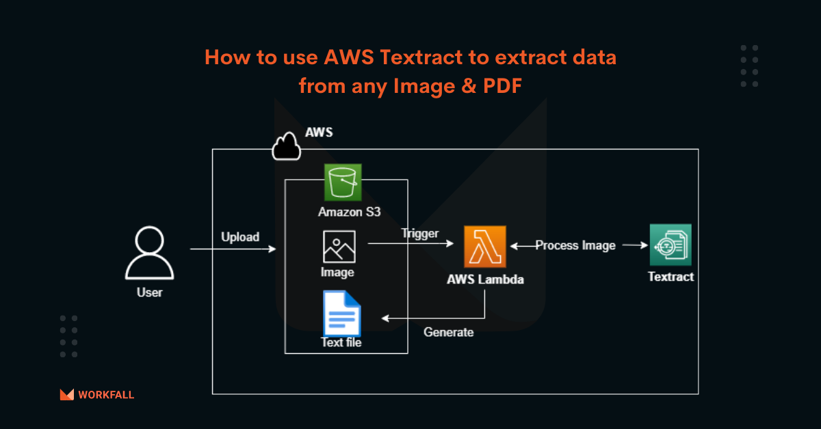
Architecture

Slide 10
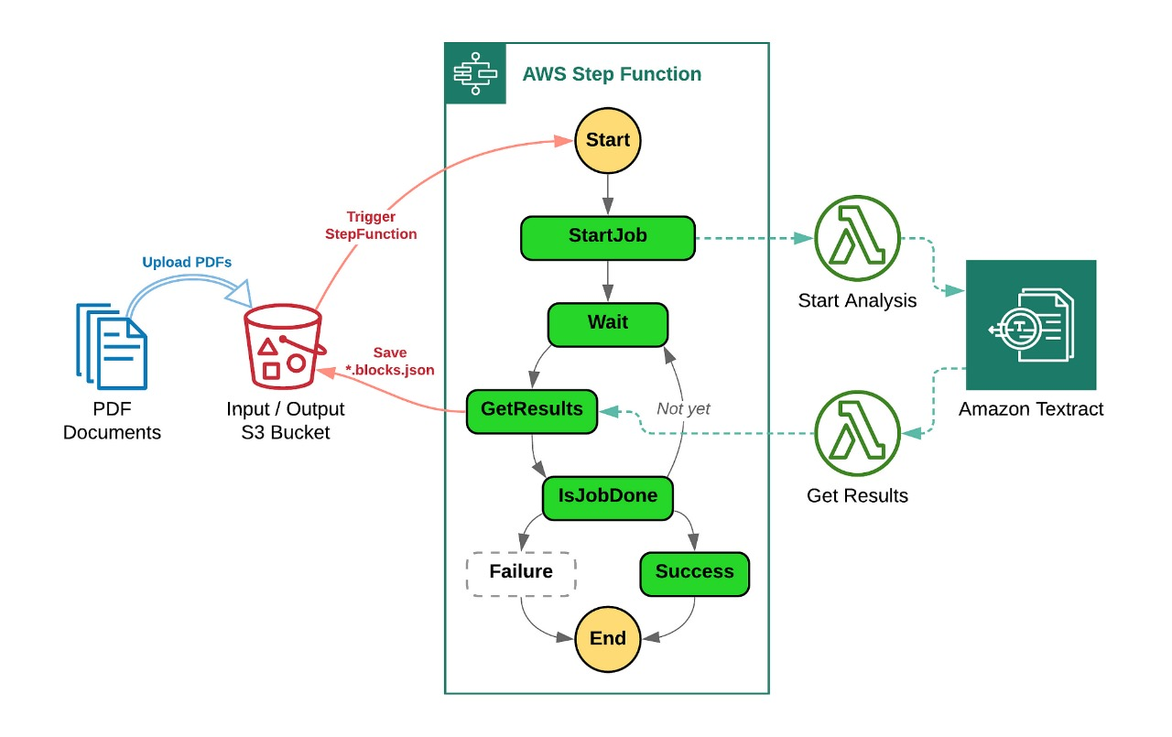
Block Diagram

Slide 11
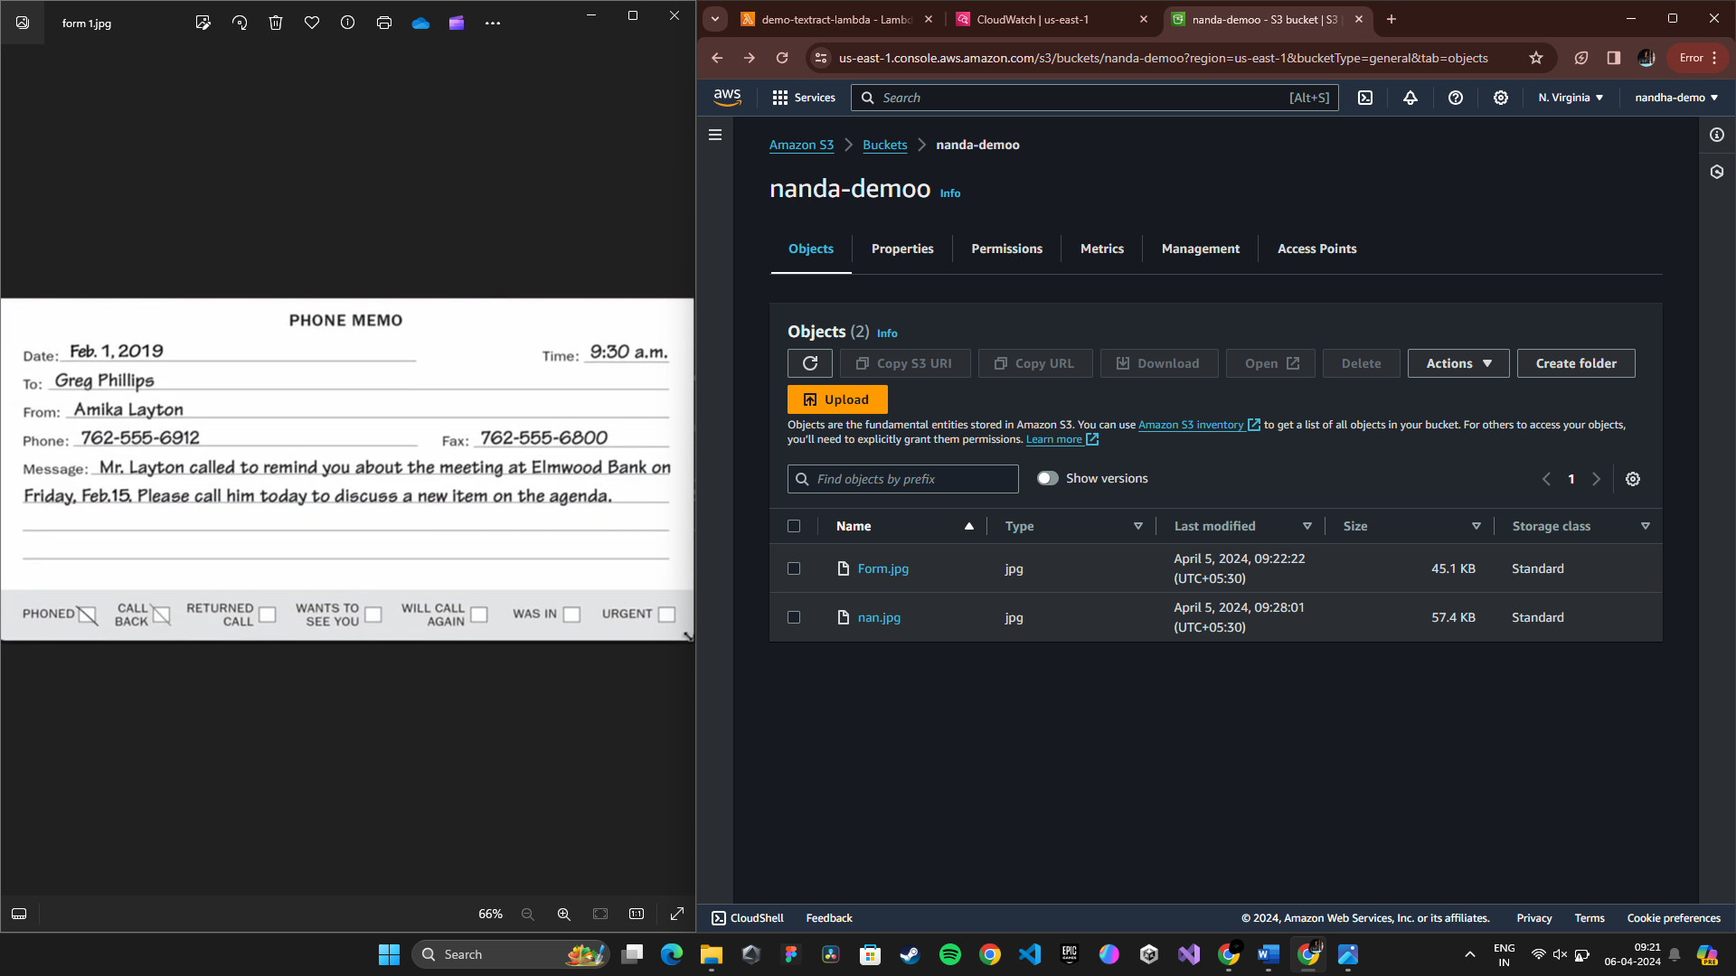
Inputs

Slide 12
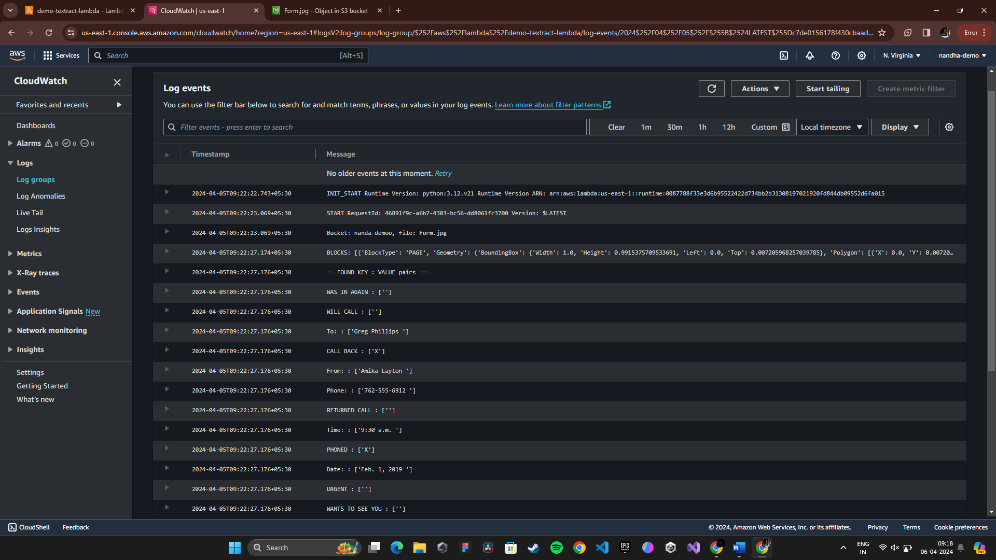
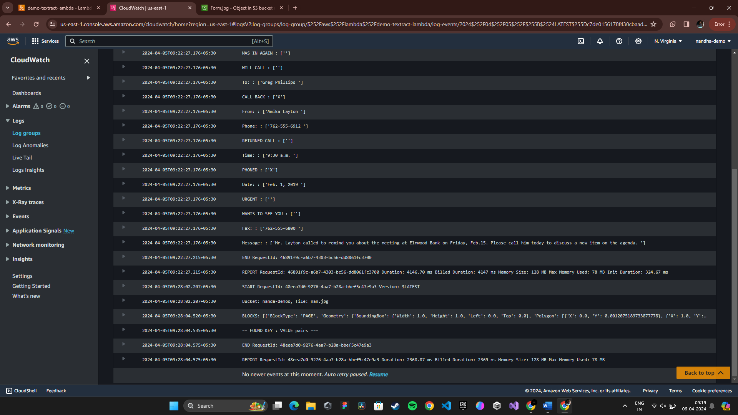
Output
Extracted Text from the Input Documents

Slide 13
References
Author(s): Sharma, A., & Jain, R.
Year : 2019
Title: "Efficient Text Extraction Techniques for Large-Scale Document Analysis
2. Author(s): Garg, S., & Anand, R. S.
Year: 2020
Title: A Survey of Text Extraction Techniques
3. Author(s): Mohanty, P., & Patel, S. K.
Year : 2019
Title: Text Extraction from Images: A Review
4. Author(s): Xu, Z., Huang, Z., Deng, H., & Zhao, Y.
Year: 2020
Title: Deep Learning for Document Processing: From Text Detection to Text Extraction

Slide 14
Conclusion:
The automation of document processing using Amazon Textract, AWS Lambda, and Amazon S3 offers a powerful solution for improving efficiency, reducing errors, and unlocking new possibilities in data extraction and analysis. By leveraging machine learning and serverless computing, this system provides a scalable, cost-effective, and accurate method for extracting key information from documents in real time.
In real-world environments, such a system can be applied across various industries, including finance, healthcare, legal, and more, where document processing is a critical part of operations. The benefits of automation, scalability, accuracy, and cost-effectiveness make this solution highly valuable for organizations looking to streamline their document processing workflows and improve overall efficiency.

Slide 15
Thankyou

